Slide 1
Chapter 3
Hinduism

Slide 2
Introduction
Hinduism is the oldest global religion, with the Vedas (the religious texts) being first carried orally sometime between 8000–6000 BCE.
Considerable debate persists about the earliest origins of Hinduism.
The term “Hinduism” itself is also controversial, for it is a name given by outsiders.

Slide 3
"Hinduism" as a Phenomena
First used in English in 1830
Originated in Persian language (area in and around Iran)
Muslims (1200-1750)
British (1750-1947)
Notes:
Since it is not possible here to trace all these diffuse, widely scattered strands in their complex historical development, we will instead explore the main facets of the Brahmanic tradition thematically: its philosophical and metaphysical elements, then its devotional and ritual aspects, and, finally, its features as a way of life. These are not in fact totally separate categories, but we will separate them somewhat for clarity. Afterward, we will look at global and political aspects of the contemporary practice of Hinduism.

Slide 4
Introduction
This chapter, therefore, focuses on the main facets of the Brahmanic tradition that is typically referred to as “Hinduism.”
Students coming to understand this religion need to become familiar with an array of terms.
Though numerous, these terms are extremely important for grasping major concepts and practices in this diverse faith.
There are 84 flashcards for this chapter

Slide 5
Introduction
The Hindi term “dharma” is often translated as “religion” in the broadest sense of the word (i.e., natural law, social welfare, ethics, health, wealth, power, etc.).
Hinduism is not easily separated from other dharmic traditions due to cross-pollination between the religions (Buddhism, Jainism, and Sikhism).

Slide 6
Introduction
Hinduism encompasses a wide array of beliefs and practices, as well as a substantial technical vocabulary, and as a result we may find it overwhelming.
Spiritual expressions of Hinduism range from extreme asceticism to extreme sensuality.

Slide 7
Introduction
Rather than attempting to trace the history of each strand of tradition, this chapter adopts a thematic approach to aspects of Hinduism:
1. Philosophical and metaphysical elements
2. Major philosophical systems
3. Religious foundations and theistic paths
4. The Hindu way of life
5. Hinduism in the modern world

Slide 8
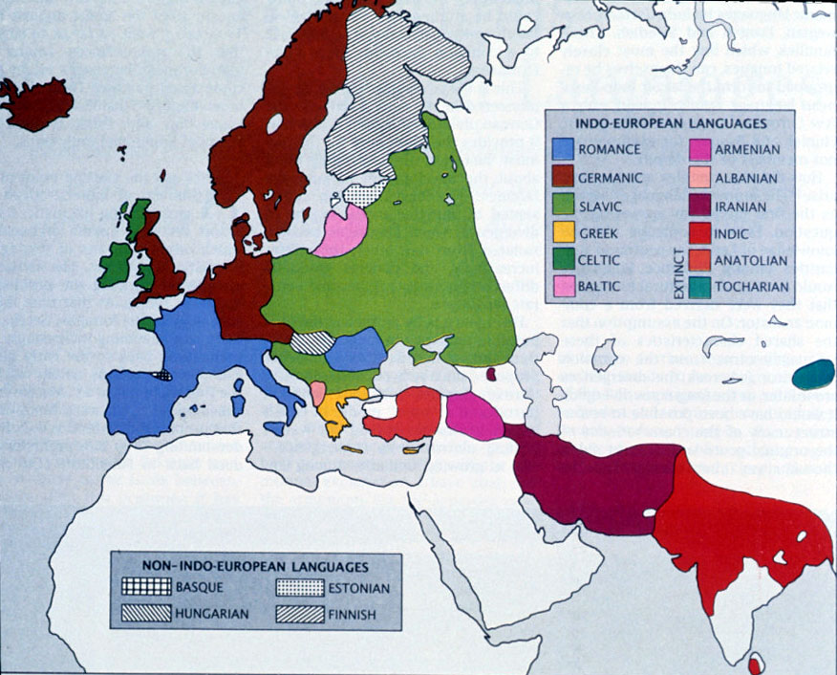
Indo-European Languages Linguistic similarity
Notes:
Indo-European languages SLIDE #2
Geographic range and location, sublanguage family
Dominant metaphor is biological, so we speak of language families, sub-families, and even daughter languages that develop from previous languages
1786 English judge, Sir William Jones, similarities between Sanskrit, Greek, and Latin
How do we know this?
Lexical (Cognates in linguistics are words that have a common origin.) Examples from Haus / house in German; manifestation f noun; deva in Sanskrit and Indian languages, divine or deity in English, Agni – ignite or igneous
Grammatical
Biological model, racial, diffusion models

Slide 9
Indo-European Languages Linguistic similarity
The majority of terms are in Sanskrit, an Indo-European language distantly related to English (for example, the name of the god of fire, Agni, is cognate with the English word “ignite”).
Notes:
Indo-European languages SLIDE #2
Geographic range and location, sublanguage family
Dominant metaphor is biological, so we speak of language families, sub-families, and even daughter languages that develop from previous languages
1786 English judge, Sir William Jones, similarities between Sanskrit, Greek, and Latin
How do we know this?
Lexical (Cognates in linguistics are words that have a common origin.) Examples from Haus / house in German; manifestation f noun; deva in Sanskrit and Indian languages, divine or deity in English, Agni – ignite or igneous
Grammatical
Biological model, racial, diffusion models

Slide 10
Indo-European Languages Linguistic similarity
Hinduism has extreme variations, and these reflect the great age of the faith tradition.
Hindu practices vary from extreme asceticism to extreme sensuality; from personal devotion to abstract philosophy; and from a sense of the oneness of the divine to the claim that there are 330 million deities.
These aspects, some scholars argue, make it difficult to define a central tradition called Hinduism.
Notes:
Indo-European languages SLIDE #2
Geographic range and location, sublanguage family
Dominant metaphor is biological, so we speak of language families, sub-families, and even daughter languages that develop from previous languages
1786 English judge, Sir William Jones, similarities between Sanskrit, Greek, and Latin
How do we know this?
Lexical (Cognates in linguistics are words that have a common origin.) Examples from Haus / house in German; manifestation f noun; deva in Sanskrit and Indian languages, divine or deity in English, Agni – ignite or igneous
Grammatical
Biological model, racial, diffusion models

Slide 11
3.1 Philosophical and metaphysical origins
The Brahmanic tradition may be traced back to the Vedic age.
Metaphysical beliefs in the Vedas were divided into various schools of thought by philosophers and sages.
Notes:
Indo-European languages SLIDE #2
Geographic range and location, sublanguage family
Dominant metaphor is biological, so we speak of language families, sub-families, and even daughter languages that develop from previous languages
1786 English judge, Sir William Jones, similarities between Sanskrit, Greek, and Latin
How do we know this?
Lexical (Cognates in linguistics are words that have a common origin.) Examples from Haus / house in German; manifestation f noun; deva in Sanskrit and Indian languages, divine or deity in English, Agni – ignite or igneous
Grammatical
Biological model, racial, diffusion models

Slide 12
3.1 Philosophical and metaphysical origins
The history and precise dating of this period is controversial.
Initially, scholars believed the “Aryans” from the north invaded the Indus Valley and developed the Vedas (an important base for the later development of Hinduism), but recent scholarship has questioned that.
Notes:
Indo-European languages SLIDE #2
Geographic range and location, sublanguage family
Dominant metaphor is biological, so we speak of language families, sub-families, and even daughter languages that develop from previous languages
1786 English judge, Sir William Jones, similarities between Sanskrit, Greek, and Latin
How do we know this?
Lexical (Cognates in linguistics are words that have a common origin.) Examples from Haus / house in German; manifestation f noun; deva in Sanskrit and Indian languages, divine or deity in English, Agni – ignite or igneous
Grammatical
Biological model, racial, diffusion models

Slide 13
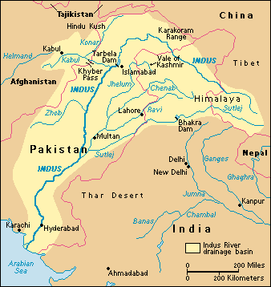
Indus River and Valley

Slide 14
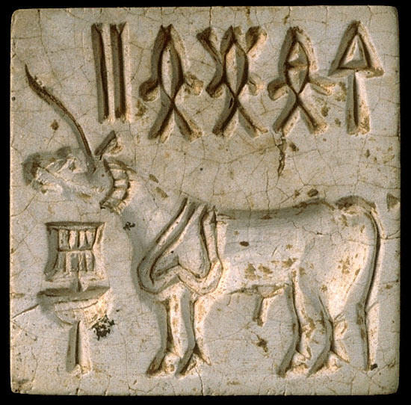
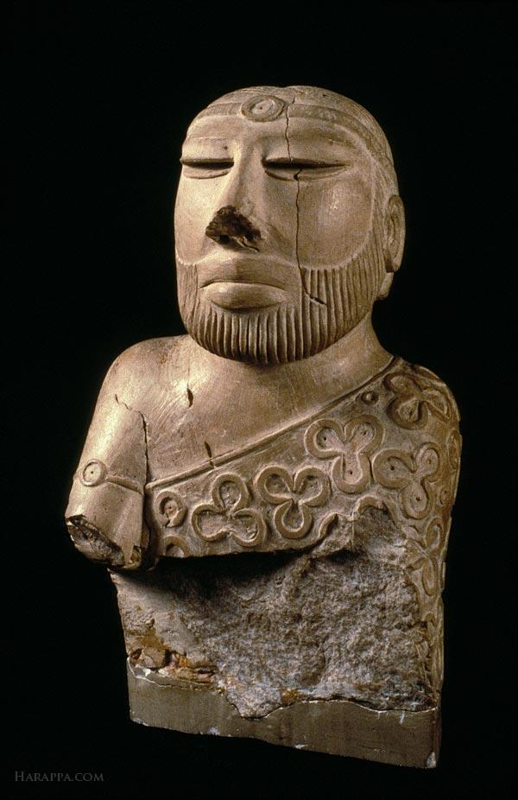
The Indus Valley Civilization (2 of 3)
A seal for marking goods with undeciphered script
This statue is tiny. A little under 7 inches tall. A god? A priest? A king?

Slide 15
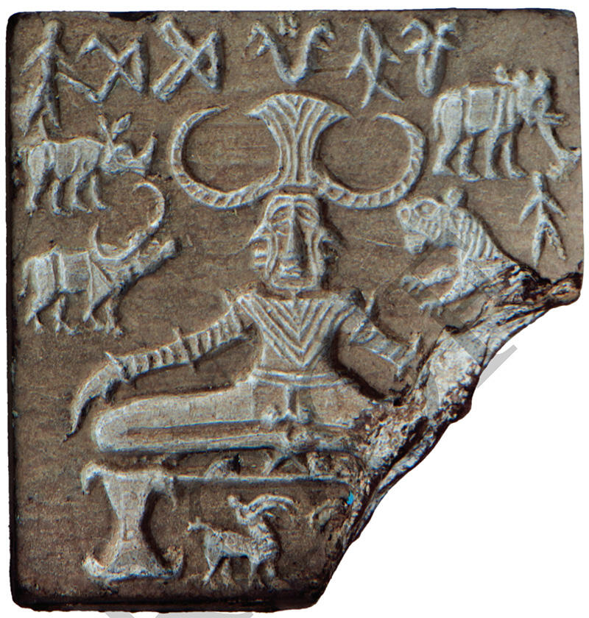
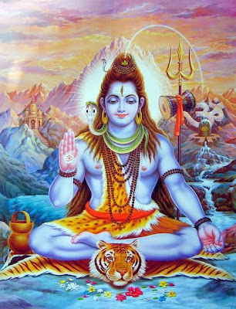
The Indus Valley Civilization (3 of 3)
A seal for marking goods with undeciphered script. A yogi? A god?
An early form of the god Shiva?

Slide 16
3.1 Philosophical and metaphysical origins
Much of the controversy rests on interpretation of archeological data and is complicated by the fact that the script used by the Indus Valley people has not yet been deciphered.
Current research suggests that changes in Indus Valley sites were brought about by small-scale migrations over time rather than a violent Aryan invasion.
Notes:
Indo-European languages SLIDE #2
Geographic range and location, sublanguage family
Dominant metaphor is biological, so we speak of language families, sub-families, and even daughter languages that develop from previous languages
1786 English judge, Sir William Jones, similarities between Sanskrit, Greek, and Latin
How do we know this?
Lexical (Cognates in linguistics are words that have a common origin.) Examples from Haus / house in German; manifestation f noun; deva in Sanskrit and Indian languages, divine or deity in English, Agni – ignite or igneous
Grammatical
Biological model, racial, diffusion models

Slide 17
3.1 Philosophical and metaphysical origins
Students may wonder whether there is any connection between the term Aryan as used here and its usage in Nazi ideology.
Aryan is originally a Sanskrit word. Students who investigate visual representation of Hindu deities may also notice swastikas; “swastika” too is a Sanskrit word, meaning “well-being.” These terms as used in Hinduism have nothing to do with Nazism.
Notes:
Indo-European languages SLIDE #2
Geographic range and location, sublanguage family
Dominant metaphor is biological, so we speak of language families, sub-families, and even daughter languages that develop from previous languages
1786 English judge, Sir William Jones, similarities between Sanskrit, Greek, and Latin
How do we know this?
Lexical (Cognates in linguistics are words that have a common origin.) Examples from Haus / house in German; manifestation f noun; deva in Sanskrit and Indian languages, divine or deity in English, Agni – ignite or igneous
Grammatical
Biological model, racial, diffusion models

Slide 18
3.1 Philosophical and metaphysical origins
The relationship of the Vedas to the Indus Valley is also in question in modern scholarship.
While it is difficult to reach definite answers about this controversy, we can study the Vedas to learn more about the early foundations of Hinduism.
It is important to note that the Vedas are the foundation of upper-caste Brahmanic Hinduism but not necessarily all forms of Hinduism.
Notes:
Indo-European languages SLIDE #2
Geographic range and location, sublanguage family
Dominant metaphor is biological, so we speak of language families, sub-families, and even daughter languages that develop from previous languages
1786 English judge, Sir William Jones, similarities between Sanskrit, Greek, and Latin
How do we know this?
Lexical (Cognates in linguistics are words that have a common origin.) Examples from Haus / house in German; manifestation f noun; deva in Sanskrit and Indian languages, divine or deity in English, Agni – ignite or igneous
Grammatical
Biological model, racial, diffusion models

Slide 19
The Vedas
The Vedas are a collection of sacred hymns; the names of the different portions of the collection may be difficult for students.
The Rig Veda is the first and oldest of four collections that constitute the Vedas.
It praises and asks blessings from the devas or deities.
The other three collections contain hymns and sacred sounds for offerings to the devas.

Slide 20
The Vedas
Other ancient shruti texts include the Brahmanas, the Aranyakas, and Upanishads.
The Upanishads represent mystical insights and focus on inward self-exploration as means of knowing Brahman, the all-pervading reality.
At the introductory level, understanding the nature of the Vedic samhitas and the Upanishads is most important.

Slide 21
The Vedas
The Vedas were initially preserved orally, and their ritual use depends on proper oral recitation.
According to Hindu tradition, the Vedas were not composed by humans but rather were heard by ancient sages or rishis and then compiled by Vyasa.

Slide 22
The Vedas
Different forms of the word “brahman.”
First, there are the Brahmanas, a portion of the Vedas
Then, there is Brahman, the all-pervading reality
There is also Brahmin/Brahman (as in “Brahmanic Hinduism”), the priestly caste.

Slide 23
The Vedas
The rishis who appear in the Upanishads taught that Brahman, the all-pervading reality, could be known from within as the subtle self or soul, atman.

Slide 24
The Vedas
The Upanishads relate key doctrines of Hinduism, such as the concept of a cycle of death and rebirth known as samsara, in which the atman is continually reborn according to the results of one’s actions, or karma.
The rishis sought to escape this cycle of death and rebirth and attain moksha, liberation from samsara.

Slide 25
3.2 Theistic foundations
The worship of major deities persisted during the Vedic period and was later written down.
Eventually bhakti, the intensive devotion to a personal manifestation of Brahman, became the heart of Hinduism.

Slide 26
The epics and Puranas
Arising after 500 CE, the epics and Puranas illustrate the trend toward personal love for a deity.
The two major epics are the Ramayana and the Mahabharata.

Slide 27
The epics and Puranas
The epics illustrate aspects of the theory of yugas or ages, according to which the cosmos passes through a series of four ages, with dharma or moral order gradually declining in each era.
Vishnu therefore incarnates himself (as an avatar) to ameliorate the situation.
The world is understood currently to be in the fourth and most degenerate age, the Kali Yuga.

Slide 28
The epics and Puranas
The Ramayana, compiled sometime between 400 BCE and 200 CE, depicts the duties (i.e., dharma) involved in various kinds of relationships through its telling of the story of the prince Rama, his wife Shita, and a wider cast of characters.
The story exists both in a Sanskrit version and multiple vernacular oral and written traditions.

Slide 29
The epics and Puranas
The vast Mahabharata, composed perhaps sometime between 4000 BCE and 400 CE, includes one of the best-known texts of Hinduism, the Bhagavad-Gita, which relates a dialogue between Krishna and Arjuna at the beginning of a battle between two sides of a family

Slide 30
The epics and Puranas
The Puranas (traditionally 18 in number), which were probably compiled between 500 and 1500 CE, detail the vast mythology of the Hindu pantheon.
Especially popular is the Bhagavata Purana, which tells the tale of Krishna as a mischievous child and his playful activities with the gopis or cowherd girls.

Slide 31
3.3 Devotional traditions
In ancient times, rituals involving fire sacrifice and recitation of the Vedas were apparently dominant.
The bhakti or devotional approach, however, gradually came to dominate around 600 CE.
It was open to both women and shudras (manual laborers and artisans), who had been excluded from direct participation in Vedic ritual.

Slide 32
3.3 Devotional traditions
There are three major groupings of people: Vaishnavas, who worship Vishnu (and deities associated with him),
Shaivas, who worship Shiva (and deities associated with him), and
Shaktas, who worship a Mother Goddess.
While many people have a chosen deity, they may also worship other deities for various reasons.

Slide 33
3.3 Devotional traditions
There are three major groupings of people: Vaishnavas, who worship Vishnu (and deities associated with him),
Shaivas, who worship Shiva (and deities associated with him), and
Shaktas, who worship a Mother Goddess.
While many people have a chosen deity, they may also worship other deities for various reasons.

Slide 34
3.3 Devotional traditions
It is important to point out that the three major groupings do not constitute hard boundaries; people may worship a variety of gods and goddesses for various purposes at different points in their lives.

Slide 35
3.3 Shaktas
The Shakta tradition may or may not include the Vedic path.
• The power of the goddess is known as shakti. This feminine power may manifest in many forms, from village goddesses associated with a particular locale to the great goddesses of upper-class mythology.

Slide 36
3.3 Shaktas
Important goddesses include Durga, Kali, Lakshmi, and Saraswati.
The goddess may be fierce or gentle.
Her worship may be linked to nature, especially trees and rivers.
Texts called Tantras provide instructions for worshiping the feminine divine.
Shakti is a key concept for the gods as well, for each has a female consort known as his shakti

Slide 37
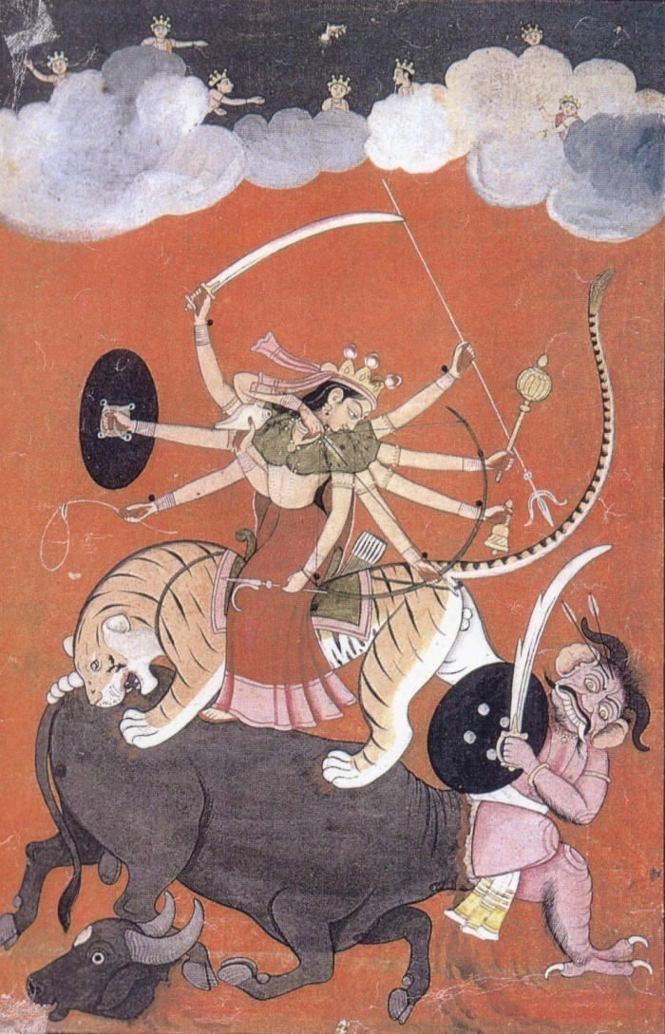
Durgā’s slaying of the great buffalo demon, Mahisha (Mahishasura)
Mahisha gains power to be the invincible conqueror of the universe from Brahma
Goes on rampage
Lower gods and Brahma, Vishnu, & Shiva emit their anger, create Durgā
Arm her with their individual weapons to defeat the demon

Slide 38
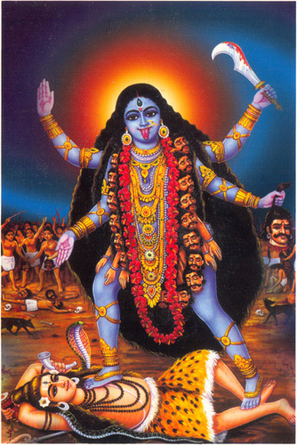
Kālī “black, dark”
Usually thought to be malevolent side of Pārvatī or Dūrga
Blood sacrifices common in eastern India, Nepal, and Bangladesh
Independent goddess not in Purāṇas, later

Slide 39
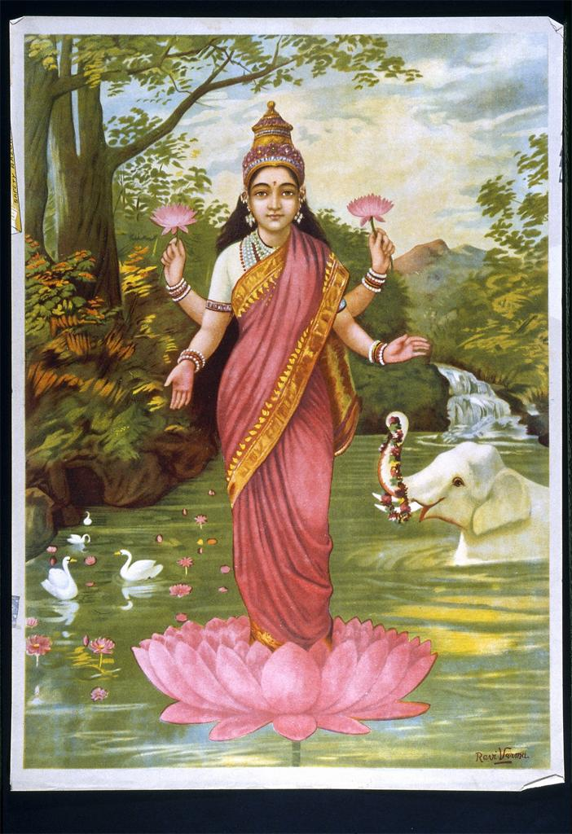
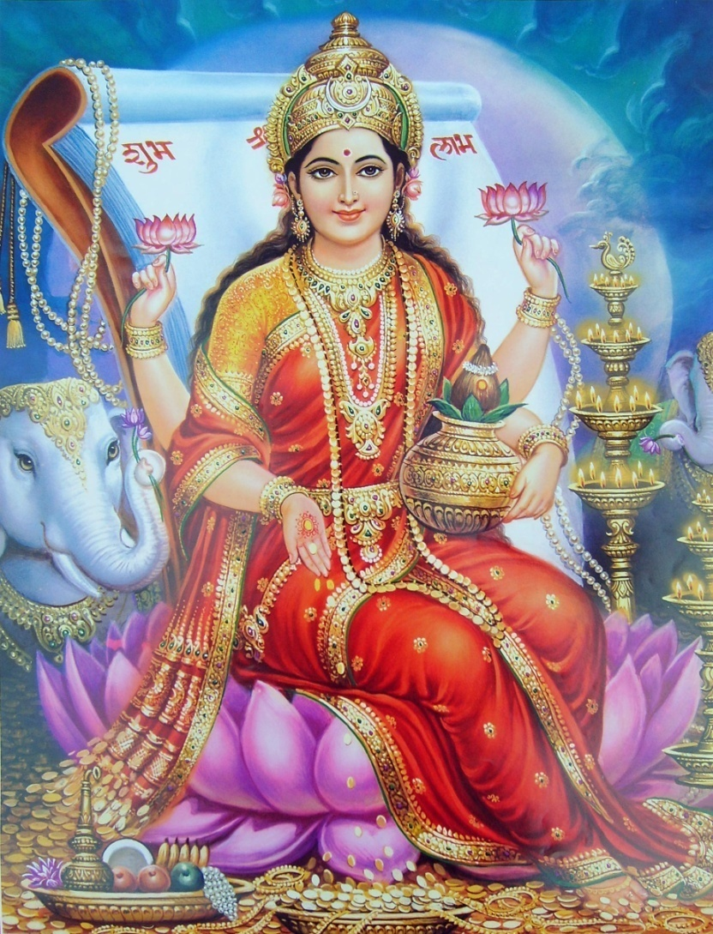
Laxmi “Goddess of Fortune”

Slide 40
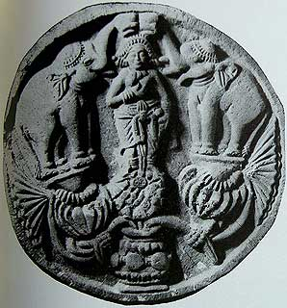
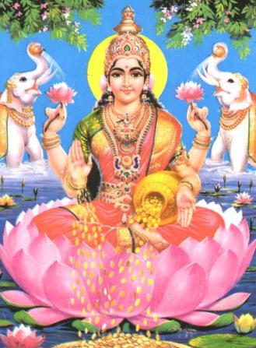
Gajalakshmi “Lakshmi with elephants”
Bharhut (2nd century BCE)
Modern poster print

Slide 41
3.3 Shaivas
The god Shiva may be represented in a variety of forms, as the lord of yoga, as husband of the goddess Parvati, and to some Shaivas as the attributeless supreme deity.
Shiva and his shakti may be portrayed together as an androgynous figure and may also be represented by a lingam within a yoni.
Shiva’s son Ganesh (created by Parvati) may be familiar to some students—he has an elephant head and his favor is sought at the beginning of any new venture.

Slide 42
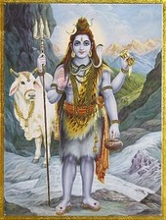
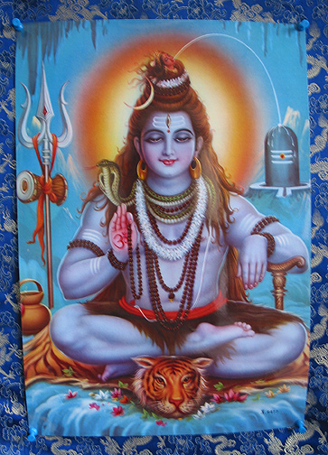
Shiva

Slide 43
3.3 Vaishnavas
The god Vishnu has been worshiped since Vedic times.
He is understood to have appeared in a series of earthly incarnations, some in animal form.
Two of his most well-known incarnations are the gods Rama and Krishna (though Krishna may be revered without reference to Vishnu).

Slide 44
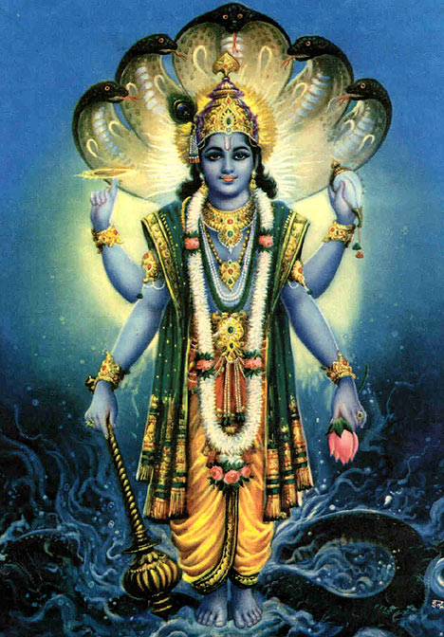
Vishnu
10 Avatars
Avatar, “incarnation”, implies a deliberate descent from higher spiritual realms to lower realms of existence for special purposes
Most important:
Rama
Krishna

Slide 45
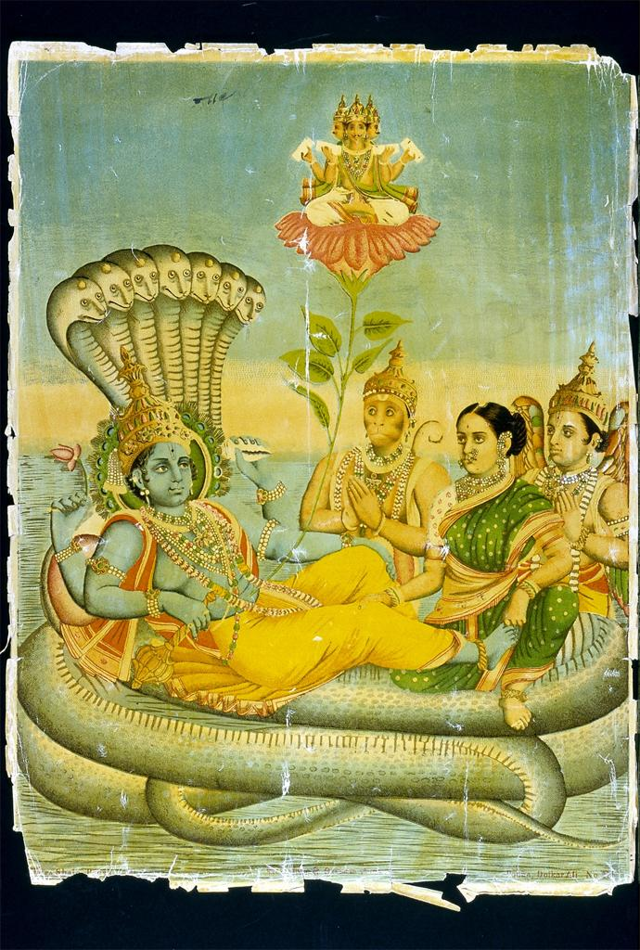
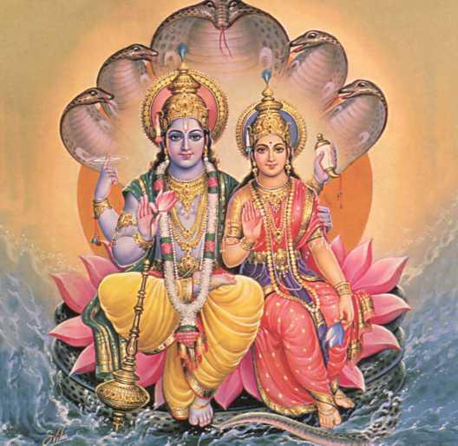

Viṣṇu and Lakṣmī

Slide 46
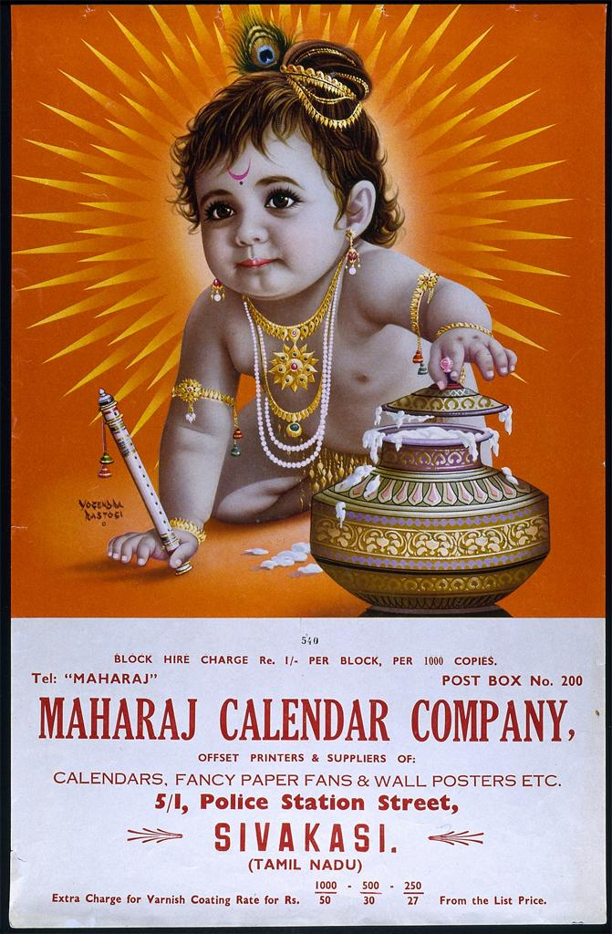
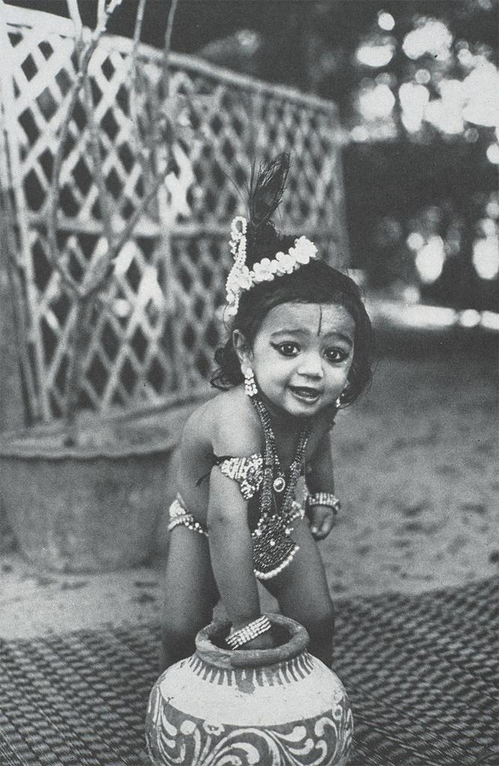
Krishna

Slide 47
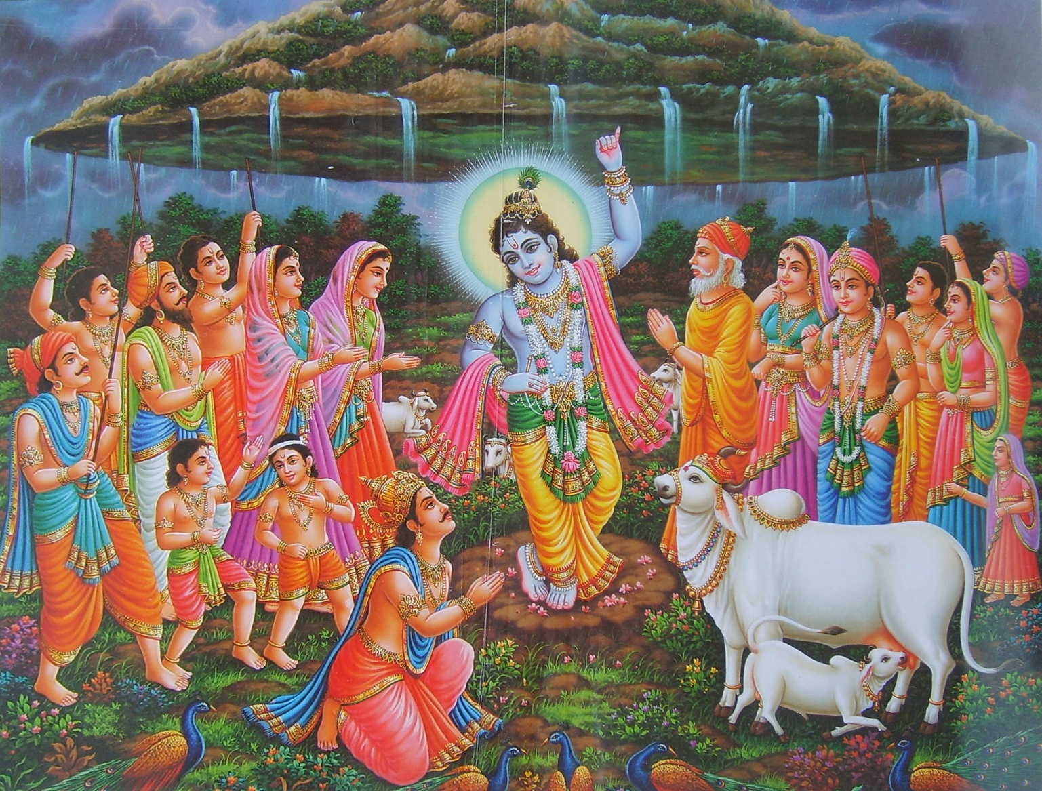
Mount Govardhan

Slide 48
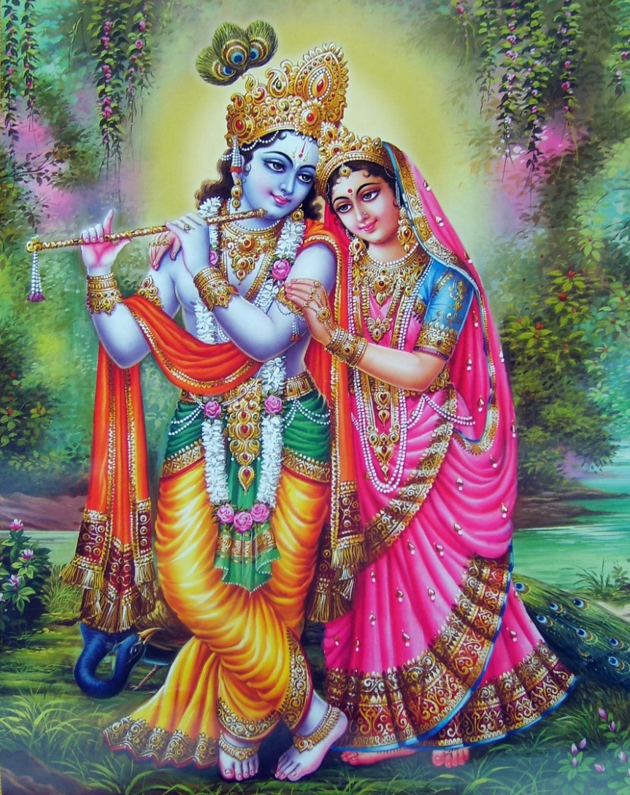
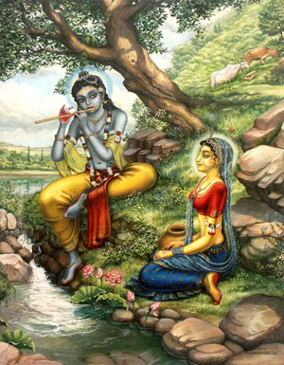
Krishna & Radha

Slide 49
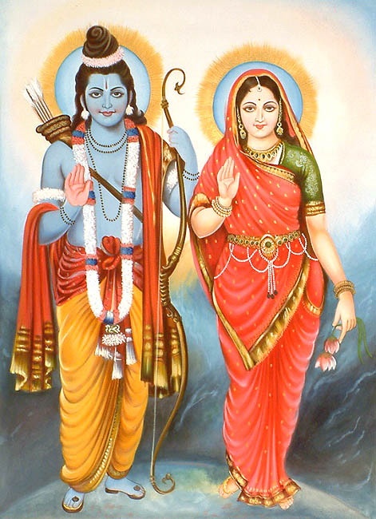
Rama & Sita

Slide 50
3.3 Vaishnavas
Krishna devotion is especially popular; the devotee may imagine himself in a close personal relationship to him, as friend, brother, mother, or beloved.
Also important is Vishnu’s consort Lakshmi, associated with prosperity.

Slide 51
3.4 Major philosophical systems
The various philosophical systems of the Brahmanic Hindu tradition share three features in common:
1. All have deep roots in the Vedas and other scriptures but also in direct personal experiences of truth through meditation.
2. All hold ethics to be central to orderly social and attribute suffering to karma (that can be corrected through more ethical behavior).
3. All hold that the ultimate cause of suffering is people’s ignorance of the Self, which is omniscient, omnipotent, omnipresent, perfect, and eternal.

Slide 52
3.4 Major philosophical systems
Important philosophical systems include the dualistic views of Samkhya (which holds that there is an eternally wise, pure changeless self known as Purusha, and Prakriti, the cause of the material universe)

Slide 53
3.4 Major philosophical systems
The monistic position of Advaita Vedanta (which holds that atman and Brahman are one and that the power of maya makes the material world seem real); and a variety of forms of yoga.

Slide 54
3.4 Samkhya
The Samkhya system is thought to be the oldest in India.
The founder is said to be semi-mythical sage, Kapila.
The principles of Samkhya appear in Jainism and Buddhism from the sixth century BCE.

Slide 55
3.4 Samkhya
This system holds that the material universe consists of three essential qualities, the interaction of which is a key factor in some Indian systems of diet and medicine:
Sattva: fine, illuminated, balanced
Raja: active, passionate
Tamas: heavy, inert, coarse

Slide 56
3.4 Advaita Vedanta
Advaita (nondualist) Vedanta is generally monistic, positing a single reality, and is based on the Upanishads.
The philosopher, Shankara, reorganized the teachings, insisting that the atman and Brahman are one in the same and that our material life is an illusion.

Slide 57
3.4 Yoga
From ancient times, people of India have practiced spiritual disciplines designed to clear the mind and support a state of serene, detached awareness.
Yoga, meaning “yoke” or “union,” is a practice that helps a person achieve balance, purity, wisdom, and peacefulness.
Yoga encompasses many forms of spiritual discipline, all of which seek self-knowledge.

Slide 58
3.4 Yoga
Yogic practice may include regulation of breathing to increase prana (“breath”; life energy), various physical postures (asanas), the use of sacred formulas or mantras, and/or concentration on a visual form that may include a yantra (cosmically symbolic linear image) or the OM symbol.

Slide 59
3.4 Yoga
Some forms of yoga focus on controlling the flow of energy through the chakras (pronounced “chuckrah”) or subtle energy centers along the spine.
Practitioners of yoga seek samadhi, union with the Absolute. Various forms of yoga are geared toward different personality types, from the active to the rational to the emotional.

Slide 60
3.4 Yoga
Sages distinguished four basic types of people and developed yogic practices suitable for each type so that each person can achieve the desired union with the Self.

Slide 61
3.4 Yoga
Raja yoga, the path of mental concentration, incorporates practices known as sadhanas, and was described in the Yoga Sutras (sutras are terse sayings or aphorisms).
Jnana yoga is the path of rational inquiry.

Slide 62
3.4 Yoga
Karma yoga is the path of right action.
Bhakti yoga is the path of devotion to a personal deity.
Most common is bhakti yoga.
Throughout the history of Hinduism, many bhaktas or devotees have composed verses expressing their love and longing for the divine

Slide 63
3.5 The Hindu way of life
Hinduism has no single founder, devotional tradition, or philosophy that defines it. However, everyday life is richly imbued with meaningful aspects of spirituality.

Slide 64
3.5 The Hindu way of life
Aspects of Hindu spirituality considered here include rituals; castes and social duties; life stages; home puja; homage to the guru; fasting; prayer; auspicious designs; reverence paid to trees and rivers; pilgrimages; and religious festivals.

Slide 65
3.5 Castes, duties, and life goals
Life in India continues to be shaped to a considerable extent by hierarchies and inequalities derived from Jati (thousands of groups denoted by shared geographical origin, language, food practices, customs and beliefs, etc.) and Varna (the traditional four-fold division of labor that ultimately became hereditary).

Slide 66
3.5 Castes, duties, and life goals
The Varna caste system goes back to the Vedic age.
The Vedas described four [male] occupational groups: Brahmins, Kshatriyas, Vaishyas, and Shudras.
The Untouchables (Dalits) lay outside the system. Over time, caste membership became hereditary

Slide 67
3.5 Castes, duties, and life goals
The stigma of “Untouchability” was legally abolished in 1948, though culturally, distinctions are still recognized.
Caste distinctions are now being treated as a human rights issue.

Slide 68
3.5 Castes, duties, and life goals
The Code of Manu outlines rules for social life.
Mahatma Gandhi fought against the social injustices of the caste system, particularly discrimination against untouchables, whom he christened harijans or “children of God.”

Slide 69
3.5 Castes, duties, and life goals
Hinduism holds four major goals that define a good life: dharma, or carrying out one’s responsibilities to uphold social and cosmic order;
artha, or success in worldly activities, including the pursuit of wealth;
kama, or love and sensual pleasure, as well as aesthetic expression; and
moksha, liberation from samsara.

Slide 70
3.5 Life stages
Hinduism holds four major goals that define a good life: dharma, or carrying out one’s responsibilities to uphold social and cosmic order;
artha, or success in worldly activities, including the pursuit of wealth;
kama, or love and sensual pleasure, as well as aesthetic expression; and
moksha, liberation from samsara.

Slide 71
3.5 Life stages
In the past, spiritual training was usually available only to upper-caste males but not women and Shudras.
Traditionally, Brahmin males passed through four stages: student, householder, meditation/study, renunciation (becoming a sannyasin).
Most contemporary males do not actually follow this path.

Slide 72
3.5 Life stages
Sannyasins often renounce the world at a relatively young age, and some join a monastic order and live in a retreat community known as an ashram.

Slide 73
3.5 Life stages
For women, the ideal stages are daughter, wife, and—if her husband dies before her—widow. She is protected by her father, husband, and eldest son.
Though Brahminic Hinduism does not advocate that women become sannyasins, today an estimated 15 percent have become sannyasins.
Hindu texts do not detail religious obligations of women; however, Hindu women are actively involved in a wide range of religious activities.

Slide 74
3.5 The guru
A guru is a revered spiritual teacher and may serve as a sort of spiritual parent or spiritual guide.
Nearly every practicing Hindu places him- or herself at the feet of a guru and is grateful for the opportunities to serve his or her guru out of love.
Often, a devotee will touch a guru’s feet out of humility, which is required in order to receive teaching and because it is believed that power emanated from the guru’s feet.

Slide 75
3.5 Rituals
Ritual is central to Hinduism, and there are sixteen rites prescribed to purify and sanctify a person in his or her journey through life.
Public ritual, the puja, is usually performed by Brahmin priests called pujaris.
Important aspects of puja include darshan (visual contact with the divine; seeing and being seen by the divine) and prasad (food sanctified by being offered to a deity and/or guru and then eaten by devotees).

Slide 76
3.5 Rituals
Vedic rituals involve a havan, or sacred fireplace.
In addition to public puja, home puja is practiced with a home shrine or a prayer room for worship. Women often are responsible for daily home puja, though in orthodox homes they do not perform puja (or enter the kitchen) while menstruating.
Bodies are cremated after death, and the remains are typically submerged in a holy river.

Slide 77
3.5 Fasts, prayers, and auspicious designs
Many Hindus observe days of fasting and prayer determined by a complex lunar or solar calendar.
Astrology is very important to many Hindus (e.g., in determining time for a marriage).
Many women daily decorate the entrance to their homes with auspicious designs.
These designs are made of edible substances such as flour and rice.
The designs are broken up by birds and insects, which helps fulfill the dharmic requirement that one should feed 1,000 souls every day.

Slide 78
3.5 Reverence of trees and rivers
Rivers and particular species of trees are revered throughout India; many rivers are particularly associated with incidents in mythology.
Environmental pollution is a serious issue in contemporary India.
Ritual practices themselves, such as the immersion of the ashes of the dead in rivers and the immersion of images of deities after festivals, may contribute to the problem.
Dams, construction, and waste dumping are also threats to sacred rivers.

Slide 79
3.5 Pilgrimages
There are pilgrimage sites throughout India, some associated with particular gods or goddesses, others associated with a revered saint or teacher.
Many holy sites in India are associated with events in the epics and Puranas and visiting them is an expression of devotion to the deities associated with that place.

Slide 80
3.5 Pilgrimages
Shaktas trek to any of the fifty-one pilgrimage spots in India called shaktipithas.
Because of the powerful vibrations still believed to emit from places where great saints and teachers lived during their lives, these are important places of pilgrimage.

Slide 81
3.5 Festivals
Many festivals commemorate key events in the lives of particular gods and goddesses.
There is some sort of religious festival somewhere in India virtually every day, and most express spirituality in its happiest aspects.
Holidays are calculated partially on a lunar calendar.
Sixteen religious holidays are honored by the central government.

Slide 82
3.5 Women’s religious roles
Compared to other religions, women are highly venerated as spiritual ideals in Hinduism.
Women contribute to earthly life with dharma, marital wealth, and sensual pleasure and are seen as a critical part of spiritual life such as ceremonial sacrifice.
Marriage is ideally husband and wife as spiritual partners.
Women traditionally participate in spiritual practices only with their husbands, not as individuals.

Slide 83
3.5 Women’s religious roles
In early Vedic times, women enjoyed relative freedom to participate equally in spiritual rituals, but social changes in the nineteenth century reduced many women to being servants to their families.
In many cases—and even today—women were considered economic burdens unless they could provide a wealthy dowry

Slide 84
3.5 Women’s religious roles
Nevertheless, many women in India today are well educated and able to attain positions of power.
There are also women revered as saints and gurus who have left family obligations to achieve high levels of spiritual realization.
Tantric traditions and texts suggest that women are capable of transmitting tantric doctrines.

Slide 85
3.6 Hinduism in the modern world
The development of Hinduism has been influenced by contact with Buddhism, Jainism, and, later, Islam and Christianity.
The British and Christian missionaries criticized some Hindu practices.

Slide 86
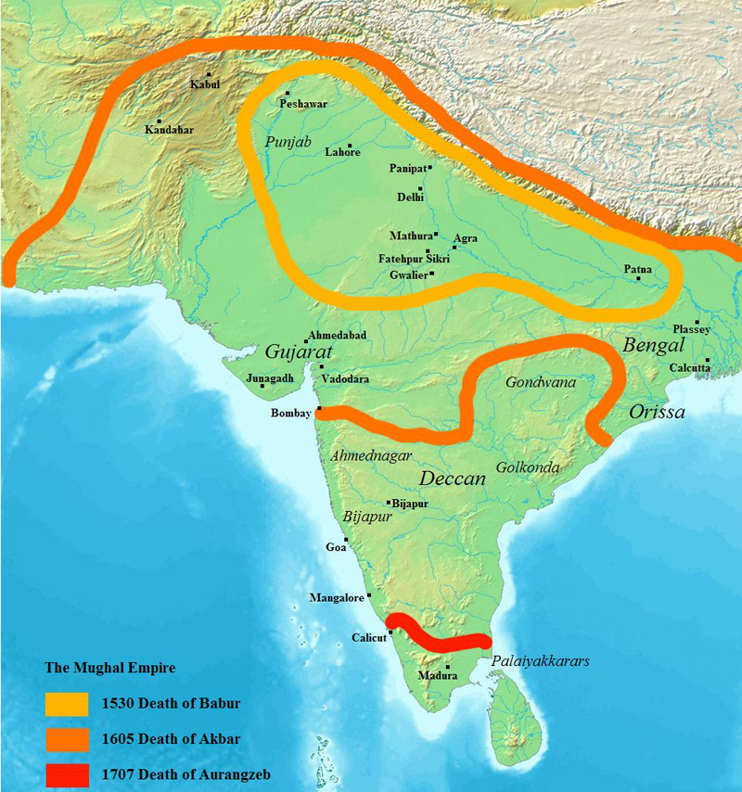
Mughal Empire 1526–1858
High point at 1707
Begins long decline at that
Early 1600s Western powers begin to establish trading centers and networks

Slide 87
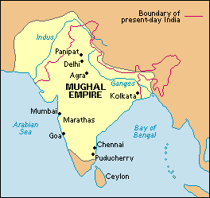
Mughal Empire at its height

Slide 88
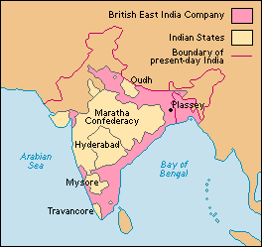
British Control of India before 1857
Early19th century
British East India Company
1612–1757
East India Company
1758
Battle of Plassey
During Seven Years War
Gains control of Bengal
Ends French influence

Slide 89
British Control of India before 1857
Early19th century
British East India Company
1757–1857
Company rule in India by a Governor-General
1813
Charter Act 1813
Opened India to Christian missionaries
1820 – British East Indian Company dominant
1857 – Indian Rebellion
Sepoys – Indian soldiers

Slide 90
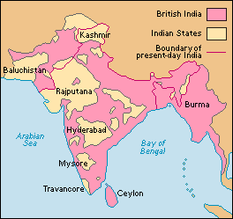
The British Raj 1858-1947
After 1857
Exposure to Western science, technology, values, education, law, and religion of Christianity
Indians began to identify and agree with criticisms of Hinduism
Reform or purify Hinduism

Slide 91
3.6 Modern movements
Various spiritual leaders revitalized Hinduism in the nineteenth century.
Mahatma Gandhi encouraged grassroots nationalism in the first half of the twentieth century

Slide 92
3.6 Modern movements
Ramakrishna (1836–1886) worshiped the divine through many Hindu paths that led to pure devotion and universal spiritual wisdom.
His follower Vivekananda carried the message of Hinduism (especially the Ramakrishna Movement and the Vedanta Society) into the world beyond India.
He taught detachment from material things for spiritual understanding.

Slide 93
3.6 Modern movements
Reform movements such as the Brahmo Samaj and Arya Samaj highlighted particular aspects of Hinduism and rejected others.
In recent years, traditional Hinduism has been challenged by social reform movements on issues of gender, caste, and poverty.
Feminist groups have also challenged traditional ideas about marriage and women’s roles.

Slide 94
3.6 Global Hinduism
Immigration and conversion have spread Hinduism far beyond the borders of the Indian subcontinent where it has left its mark on other cultures.
Movements such as Transcendental Meditation (TM) and the International Society for Krishna Consciousness (ISKCON) have brought attention to Hinduism in the West.
Contemporary gurus are also enjoying great global popularity.

Slide 95
3.6 Hindu identity
Some groups link Hinduism with Indian nationalism.
The Rashtriya Svayamsevak Sangh, or RSS, seeks to restore India to the idealized past when Ram (i.e., Rama of the Ramayana, discussed earlier) ruled.
Based on the ideology of Hindutva, or “Hinduness,” RSS ideology views Muslims and Christians as alien to India

Slide 96
3.6 Hindu identity
In contrast, India’s constitution enshrines secularism. Some groups, however, (who are sometimes termed “Hindu fundamentalists”) argue that secularism is a cover for corruption and pandering to minorities.
This controversy is illustrated through the ongoing controversy over the town of Ayodhya in northern India, the birthplace of Rama in Hindu mythology. A Muslim mosque believed by some to be the precise birthplace of Rama was destroyed in 1992.

Slide 97
3.6 Hindu identity
Extremist Hindu groups have also opposed Christianity in India.
There are also periodic conflicts between Hindu and Muslim groups in India.
Many Hindus argue that Hinduism is tolerant of all paths to the divine, a view reiterated by the Indian Supreme Court.

Slide 98
3.6 Hindu identity
Extremist Hindu groups have also opposed Christianity in India.
There are also periodic conflicts between Hindu and Muslim groups in India.
Many Hindus argue that Hinduism is tolerant of all paths to the divine, a view reiterated by the Indian Supreme Court.

Slide 99
3.6 According to the court, to be Hindu means:
1. Acceptance and reverence for the Vedas as the foundation of Hindu philosophy
2. A spirit of tolerance and willingness to understand and appreciate others’ points of view, recognizing that truth has many sides
3. Acceptance of the belief that vast cosmic periods of creation, maintenance, and dissolution continuously recur
4. Acceptance of belief in reincarnation

Slide 100
3.6 According to the court, to be Hindu means:
5. Recognition that paths to salvation and truth are many
6. Recognition that there may be numerous gods and goddesses to worship, without necessarily believing in worship through idols
7. Unlike other religions, absence of belief in a specific set of philosophic concepts

